Slide 1
Assessing
Community Needs
Rebecca Teasdale
Danielle Milam
Elizabeth Kelsen Huber

Slide 2
Objectives
Understand approaches for assessing community needs
Learn the process of needs assessment
Explore methods for gathering data

Slide 3
Defining Our Terms
Needs
Interests
Goals
Aspirations

Slide 4
Activity
How have you
assessed community needs?
Write 1 example per post-it note
Identify as many examples as you can
Stick your post-its on the wall

Slide 5
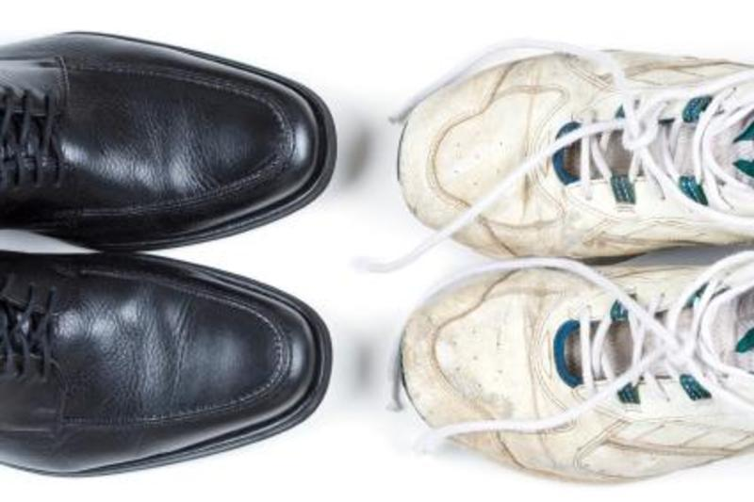

Slide 6
Formal Needs Assessment
    Systematic
    (Relatively) comprehensive
    Partners and stakeholders often participate and guide the process

Slide 7
MEETING ROOMS!
BOOKS!
MORE PARKING!

Slide 8


Slide 9
A Focus on Discrepancies
    Natural result of identifying gaps
    Highlights where action is needed
    Can result in a 1-dimensional portrait of the community

Slide 10
A Focus on Assets
    Identify resources, successes, and areas of growth
    Highlights strengths so community can build on them
    Can miss or minimize problems

Slide 11
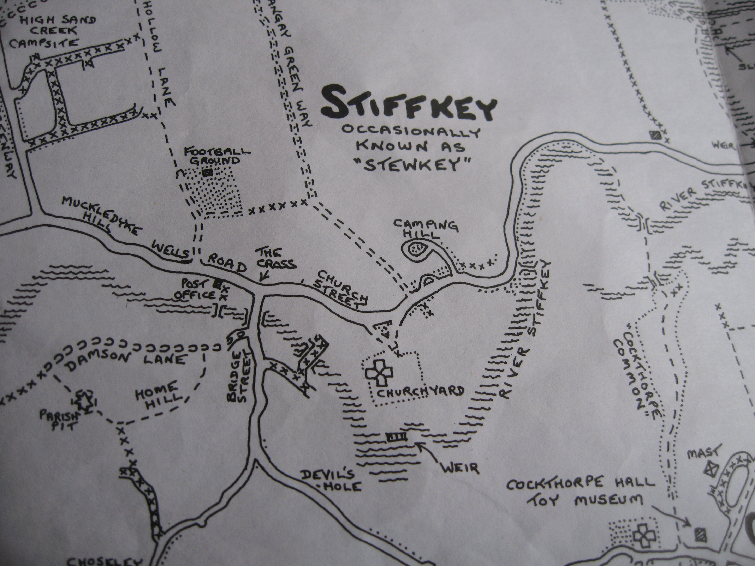
In context

Slide 12
Process
Plan
Analyze
Plan
Analyze
Collect
Act
Collect
Act

Slide 13
Plan
    Start with your questions
          What do you want to learn/explore?
          What decisions do you need to make?
    Design a process to answer your questions
          Partners and stakeholders
          Data collection methods
    Don’t forget to plan for analysis!

Slide 14
Collect
    Align data collection with our questions
    Avoid collecting “nice to know” data
    Gather existing information and/or new information
    Typically use a combination of methods

Slide 15
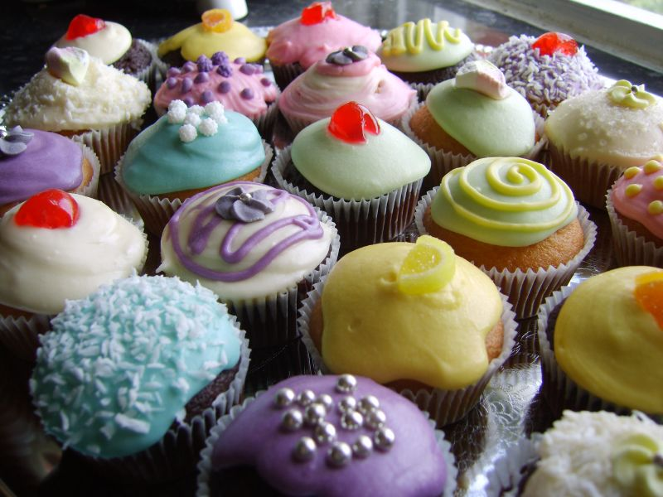
Decisions

Slide 16
Real World Examples
#1 Douglas County Library
Elizabeth Kelsen Huber
#2 Las Vegas-Clark County Library
Danielle Milam

Slide 17
Douglas County Library
    2 Models
      Embedded Librarians
      Community Interviews

Slide 18
Douglas County Library
What are the key issues facing your constituents/stakeholders over the next 1-2 years?
What do you wish you knew?
What can the library help you discover?
Where are you looking now?
What would help your organization make decisions?
Who else should we talk to?

Slide 19


Slide 20
ASSESSING
COMMUNITY NEEDS
Research Institute for Public Libraries
July 27-30, 2015 Colorado Springs CO
Presentation from Danielle Milam, Development Director
Las Vegas-Clark County Library District

Slide 21
WHAT IS THE
LIBRARY OF THE 21ST CENTURY ?

Slide 22
WHAT KIND OF COMMUNITY DO YOU WANT TO CREATE ?

Slide 23
USING BIG DATA TO ASSESS COMMUNITY
NEEDS

Slide 24
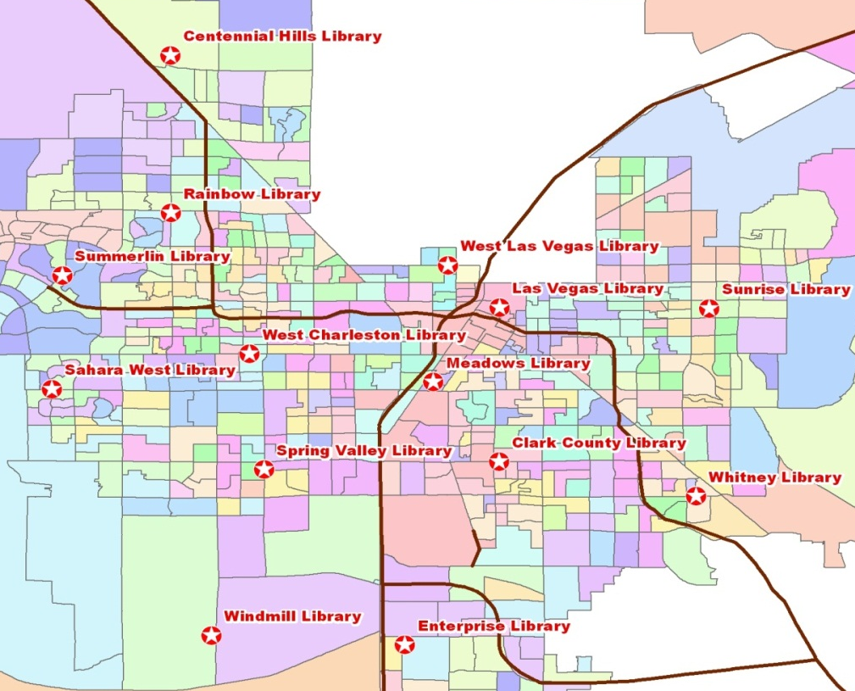
DIVERSE * FRAGMENTED * MOBILE
Out of 65 National
Segments We have 54

Slide 25
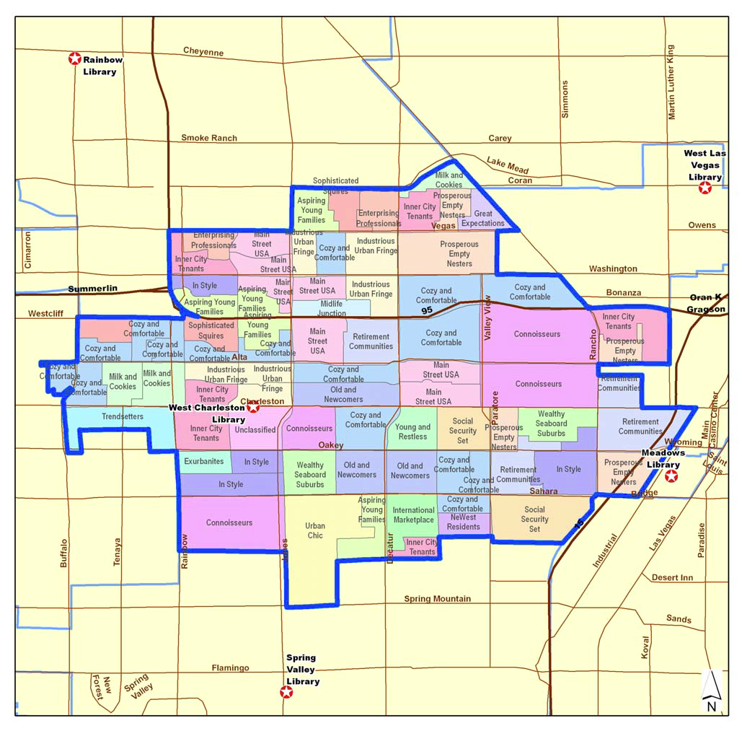
MANAGE COMPLEXITY
THIS BRANCH SERVES 21 DIFFERENT KINDS OF HOUSEHOLDS

Slide 26
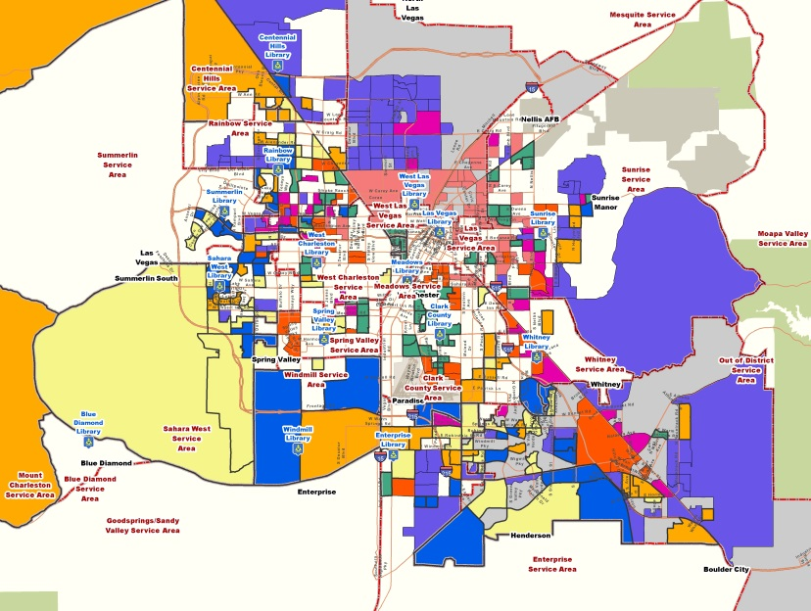
MANAGE COMPLEXITY
WE
SERVE
FAMILIES

Slide 27
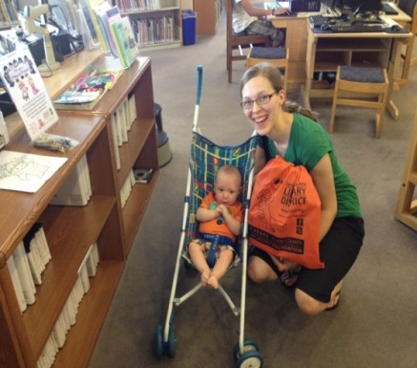
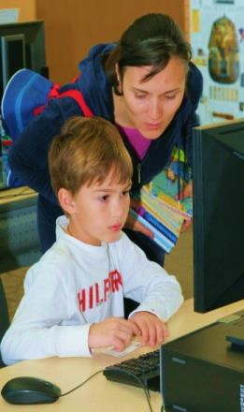
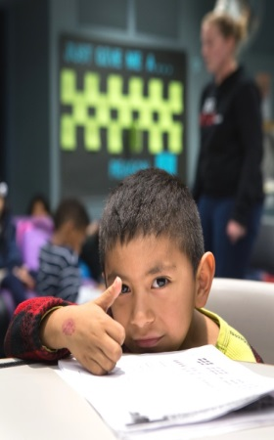
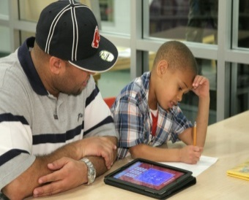
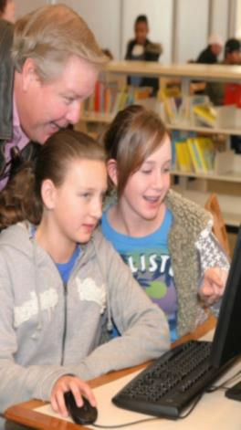
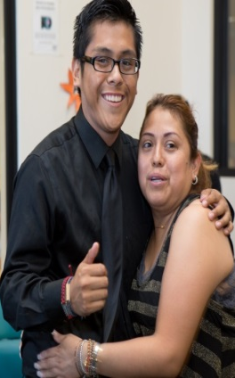
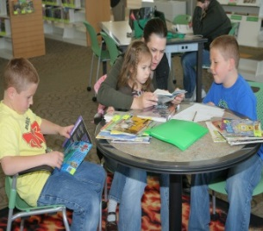
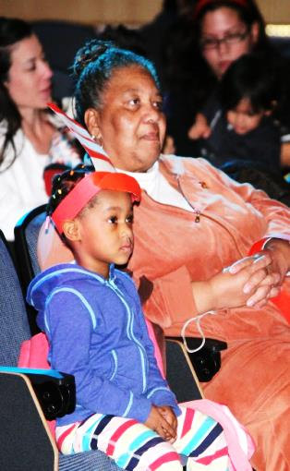

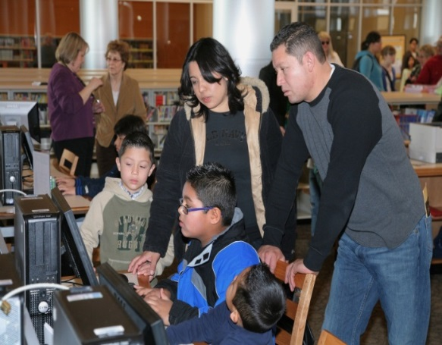
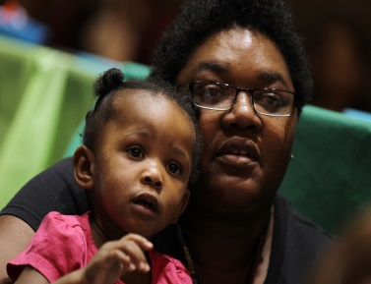
26 Kinds of Family Households

Slide 28
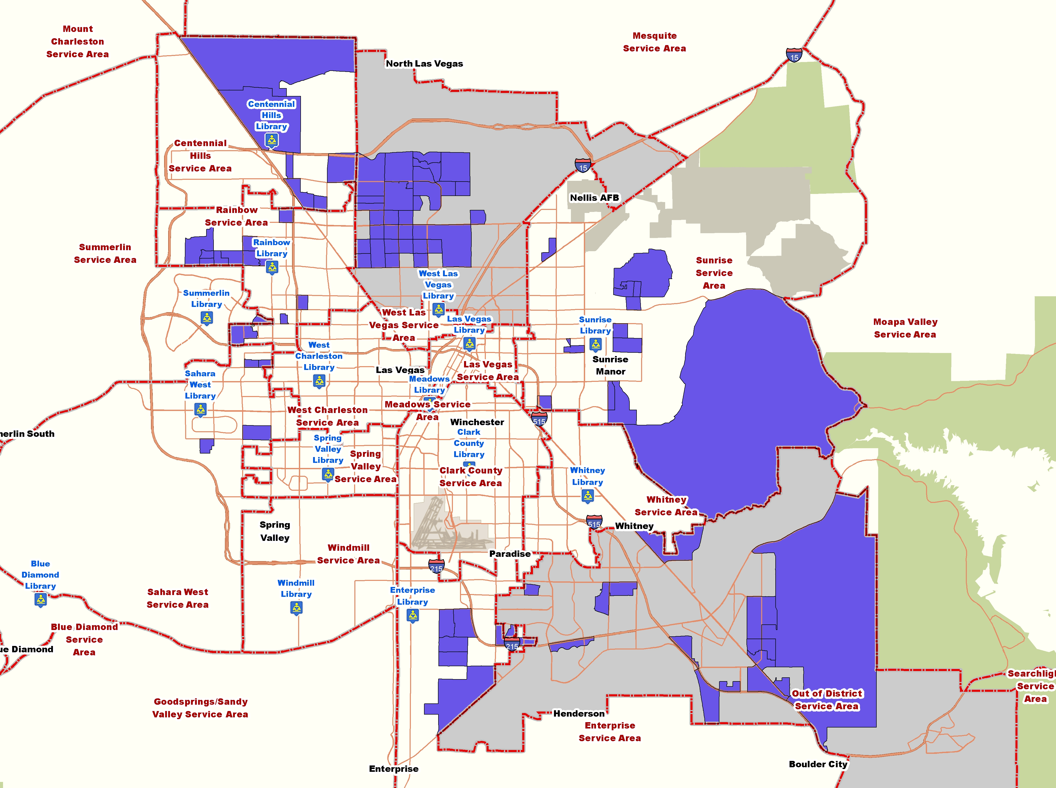
UP AND COMING FAMILIES (238,290)
LIFESTYLE AND LIFE STAGE
Mid 20s-30s
Married, w kids
Some college - Not far in career
Good earning potential
WHAT ARE THEIR INTERESTS?
Homes, Cars, Games, Media
Going to theme parks, zoos
Science fiction, comics, and family DVDs
WHAT DO THEY BUY?
Baby and maternity clothes
Furniture
Dine at Chilis, Olive Garden or fast food
HOW DO THEY GET INFORMATION?
Cable – Oxygen, eMail; FB, Twitter, YouTube, Texts

Slide 29
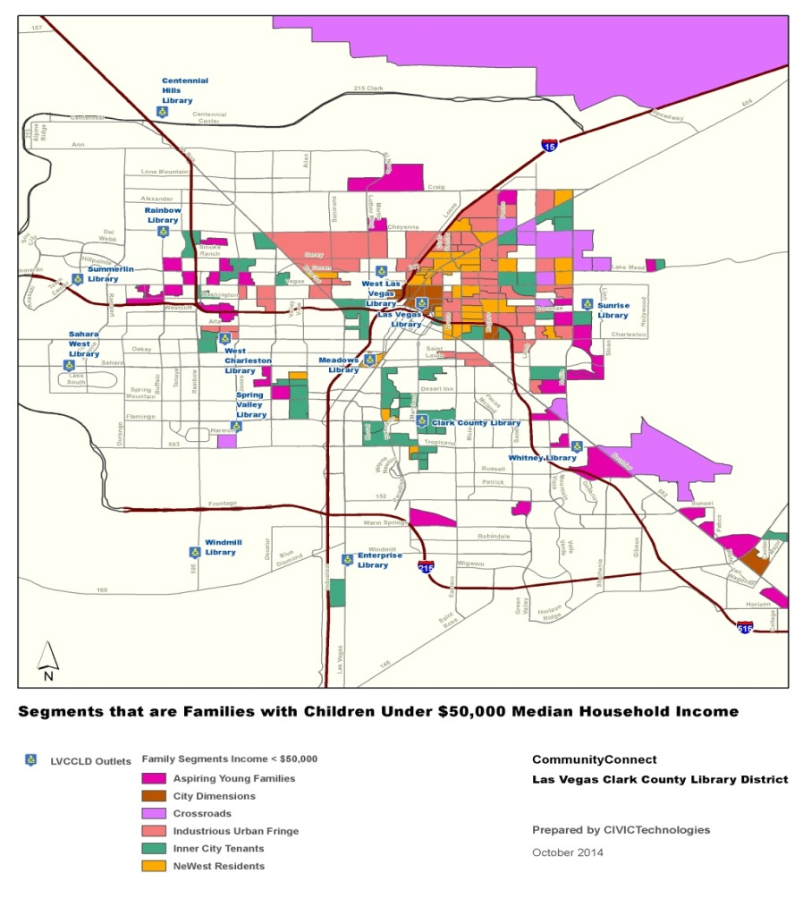
FAMILY HOUSEHOLDS UNDER $50K
Low education levels
Low income levels
Probable digital divide BUT mobile
Low English language proficiency
May need cultural bridge

Slide 30
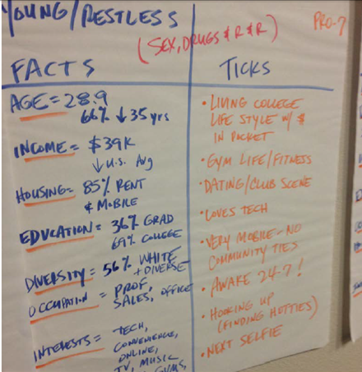
WHAT MAKES THEM TICK?

Slide 31
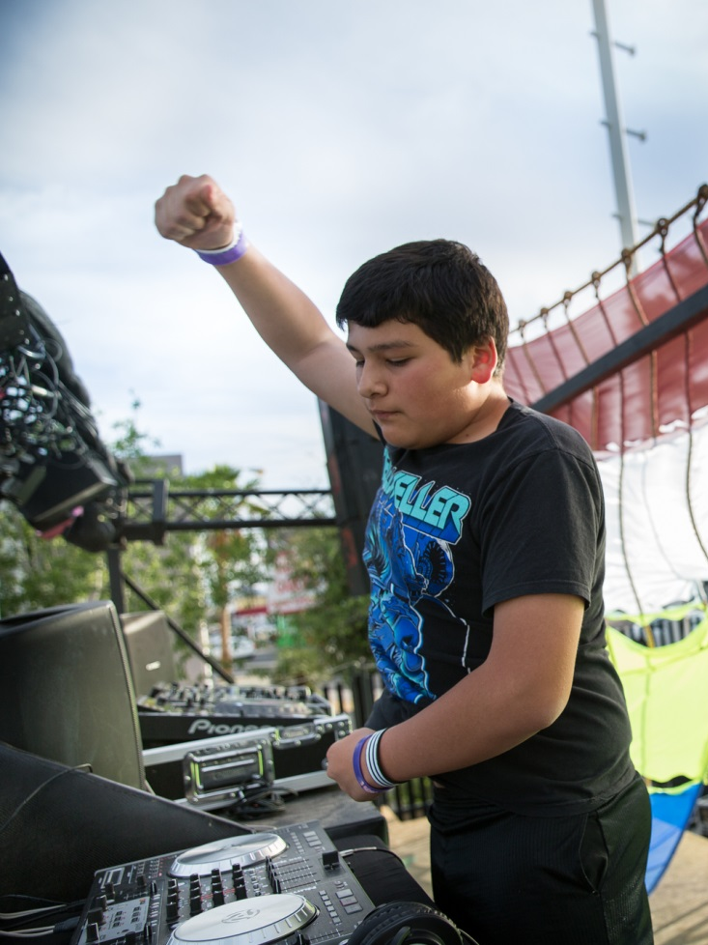
WRITE USER NARRATIVES
Jamie is a high school sophomore. His grades range from C’s to D’s and he is not sure he is headed for college or not. He has learning disabilities, gets bullied at school, and gets distracted easily. He struggles with all of the testing and sitting in the classroom during the lessons. He’s fidgety and paces around the house.
One day he finds the DJ lab at ENTERPRISE LIBRARY a couple blocks from his home. Not only does he learn some scratchin’ he helps other teens get their beats on. He gets a gig at FIRST FRIDAY as DJ DEADGOAT.

Slide 32
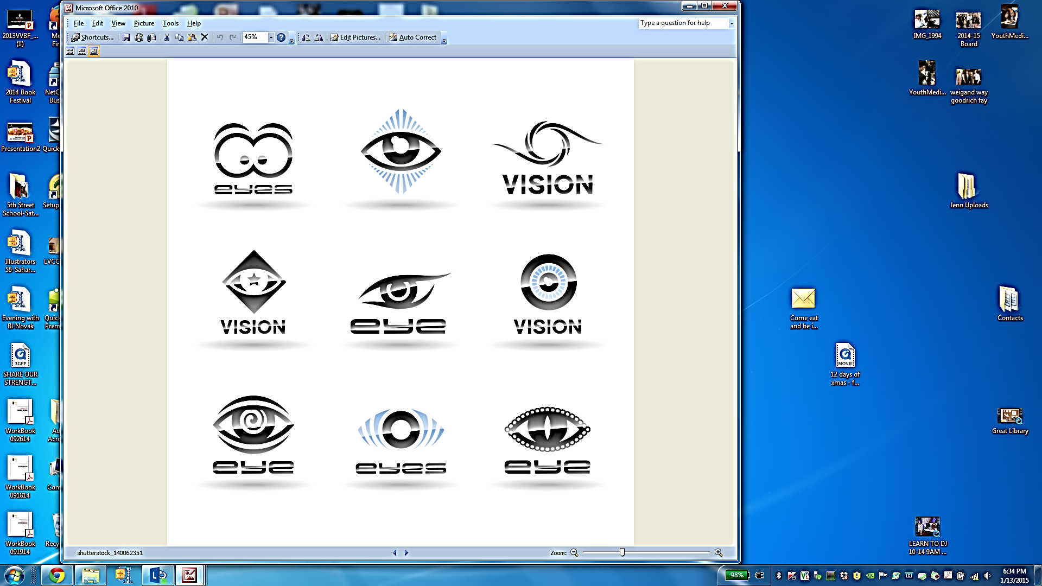
2 0 2 0 VISION
STRATEGY IMPLICATIONS FOR FAMILIES
MARKET SEGMENT GROWTH POTENTIAL (30-40 % are now patrons)
PROGRAMS: LOTS OF YOUNG FAMILIES WITH YOUNG KIDS, STUDENT SUPPORT
FOR UP & COMING, ASPIRING AND MILK AND COOKIES – pursuing higher education, financial literacy, career path
PAY ATTENTION TO INNER CITY TENANTS, INDUSTRIOUS FRINGE AND NEWWEST – school readiness, literacy, language, employment, digital literacy, internet access, career path
BRANCHES WITH BIGGEST IMPACT: SU, RB, CH, GS, SV
PROBABLY BIG DIY – limited income w/houses, cars, gardens
USE SOCIAL MEDIA, HISPANIC RADIO, GAMES, OUTREACH

Slide 33
LEARNING FROM OTHERS

Slide 34
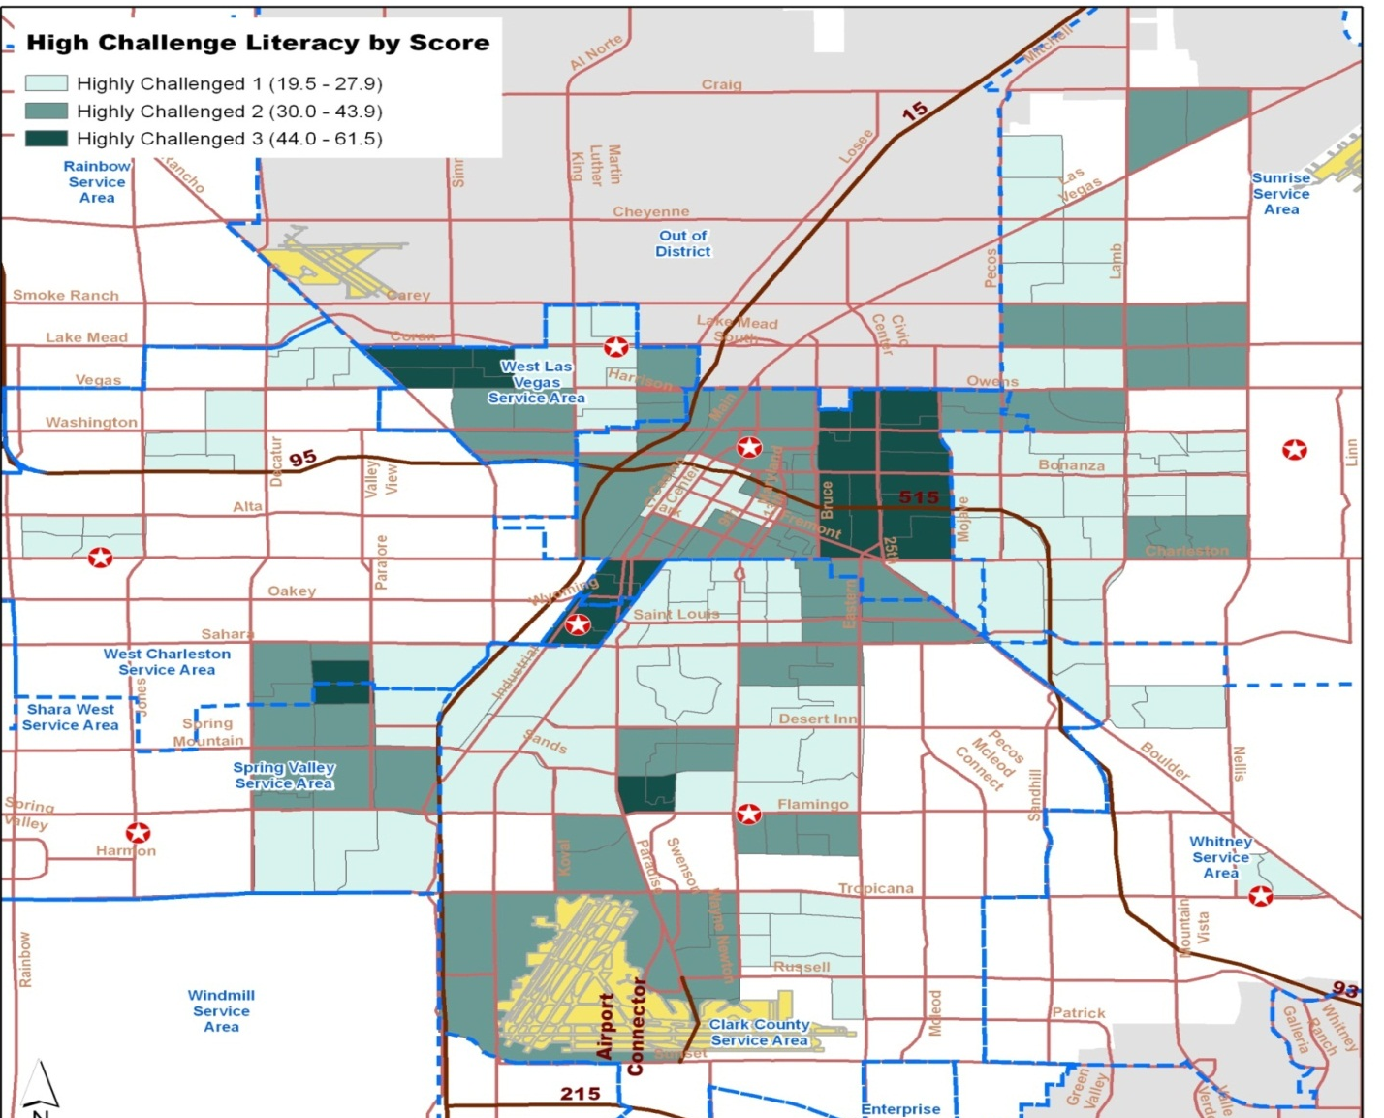
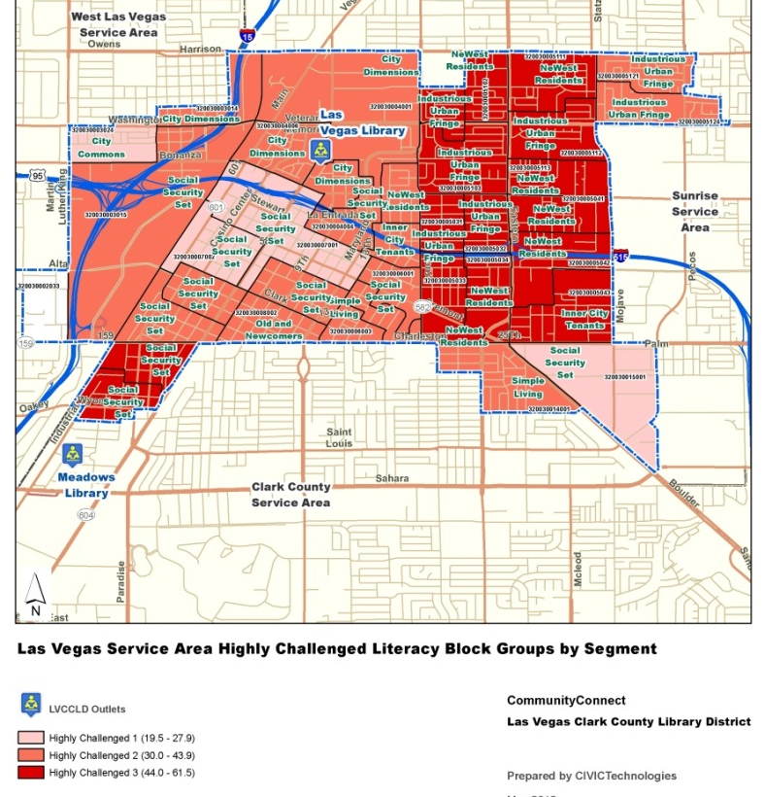
REPOSITION THE LIBRARY

Slide 35
POWER PATRON BEHAVIOR

Slide 36
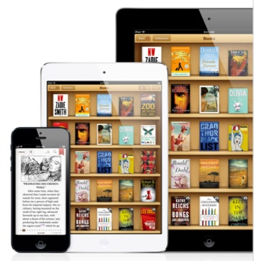
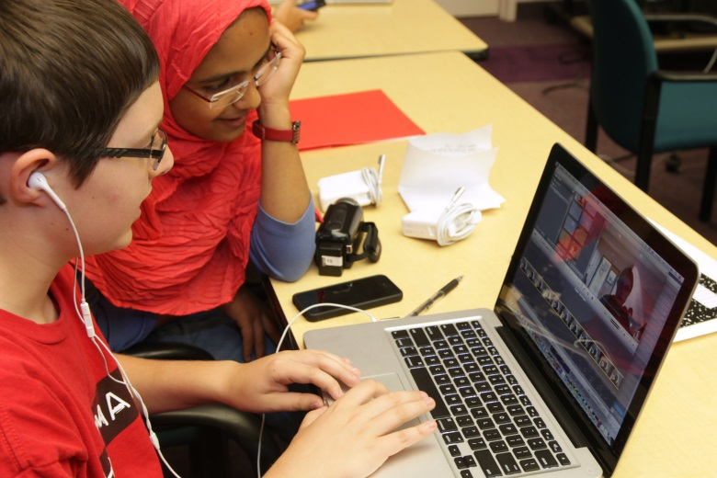
ERA OF TRANSFORMATION
As libraries shift to the digital era, they are freed from taking care of objects.
And can focus attention & public resources on real community needs.
Notes:
Not a rubber stamp

Slide 37
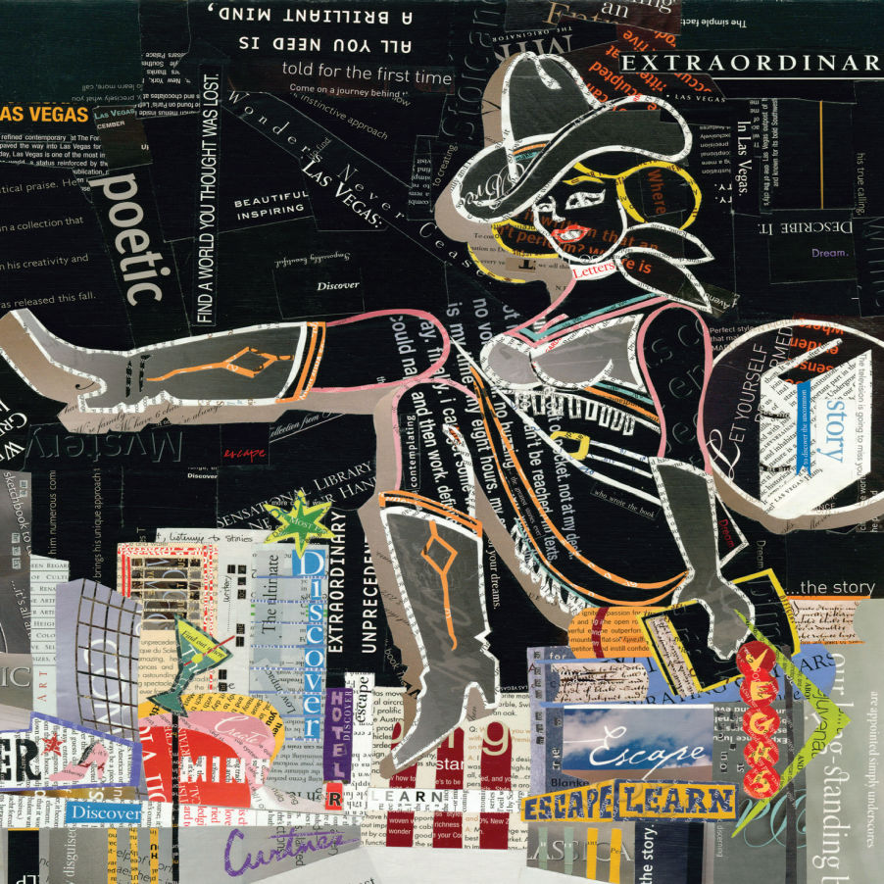
WHAT KIND OF COMMUNITY DO
YOU WANT TO
BUILD?

Slide 38
Activity
    Form a group of 3 or 4
    Review your case study
    Determine what you want to learn/explore about the community in your case study
    Design your needs assessment strategy

Slide 39
Activity
    What did you want to learn?
    What methods did you choose?
    What challenges did you encounter?

Slide 40

Reflect
Reflect

Slide 41
Photos used under Creative Commons license
    Mind the gap by Flickr user Robert S Donovan
    Hand drawn map by Flickr user Ben Bashford
    Ripples by Flickr user Gian Luigi Perrella

Slide 42
Thank you!
Rebecca Teasdale
Danielle Milam
Elizabeth Kelsen Huber

Slide 43
Office Hours (2:30-3:00)
Matt Birnbaum | Carson Block
Keith Lance | Jamie LaRue
Zeth Lietzau | Rochelle Logan
Danielle Milam | Sharon Morris
George Needham | Rebecca Teasdale

