Slide 1
Data Visualization 201: Infographic Design & Data Mapping
Linda Hofschire
Meghan Wanucha
Zeth Lietzau

Slide 2
What are your
design goals?

Slide 3
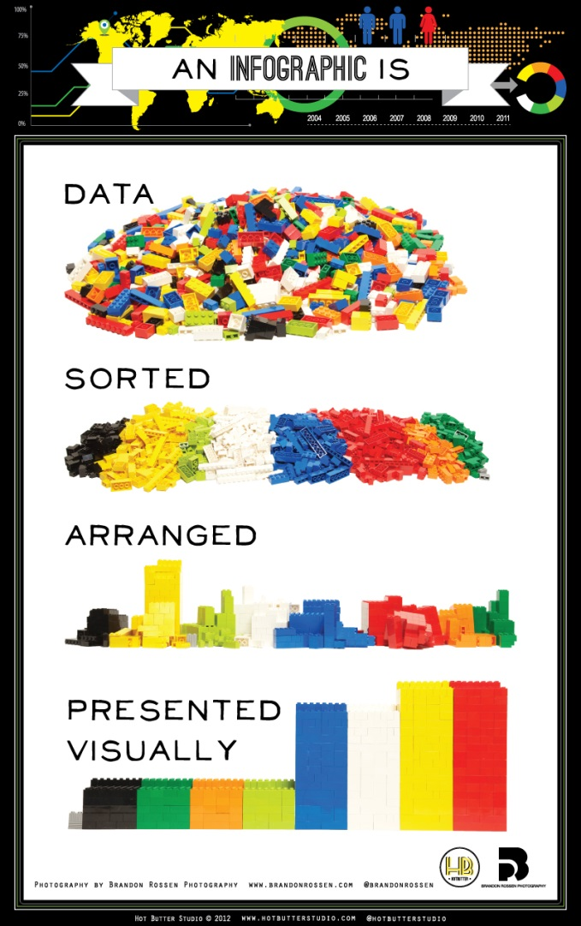
Steps for Success
Begin with numbers
Understand your goals and audience
Find your story
Design, refine, repurpose
Share
Notes:
Cohesive story
Breaking down step by step

Slide 4
Summer Reading Survey

Slide 5
Steps for Success
Begin with numbers
Understand your goals and audience
Establish your approach
Design, refine, repurpose
Share
Notes:
Cohesive story
Breaking down step by step

Slide 6
Goals and Audience

Slide 7
Goals and Audience
Each year, Colorado public libraries offer engaging summer reading programs to encourage children and teens to read for fun and to prevent summer learning loss…

Slide 8
Steps for Success
Begin with numbers
Understand your goals and audience
Find your story
Design, refine, repurpose
Share
Notes:
Cohesive story
Breaking down step by step

Slide 9
What’s the story?

Slide 10
What’s the story?
How respondent learned about summer reading
Child’s age
Plan to visit
library in fall
Summer reading participation history
Library card

Slide 11
What’s the story?
How respondent learned about summer reading
Child’s age
Plan to visit
library in fall
Summer reading participation history
Library card

Slide 12
What’s the story?

Slide 13
What’s the story?

Slide 14
What’s the story?

Slide 15
Steps for Success
Begin with numbers
Understand your goals and audience
Find your story
Design, refine, repurpose
Share
Notes:
Cohesive story
Breaking down step by step

Slide 16
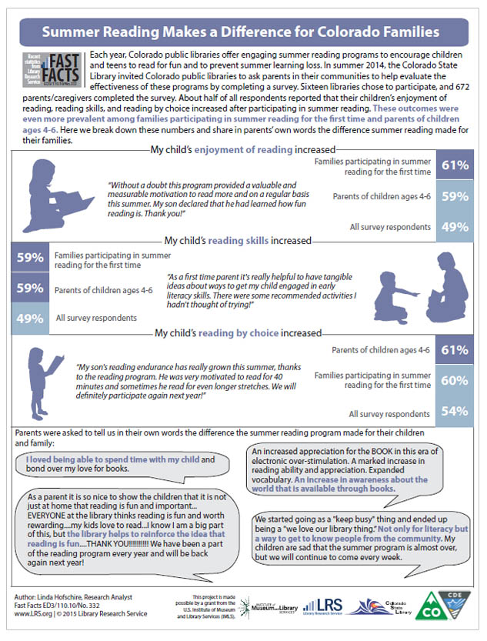

Slide 17
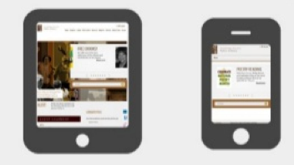
Design, Refine, Repurpose
Format—print, online, both?

Slide 18
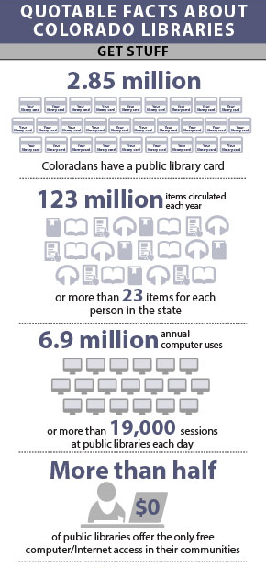
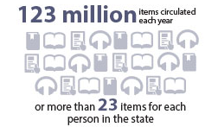

Slide 19
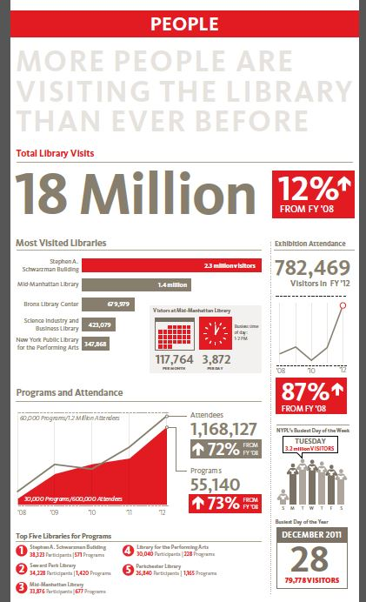
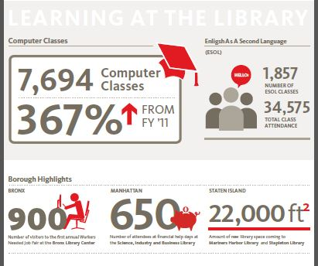
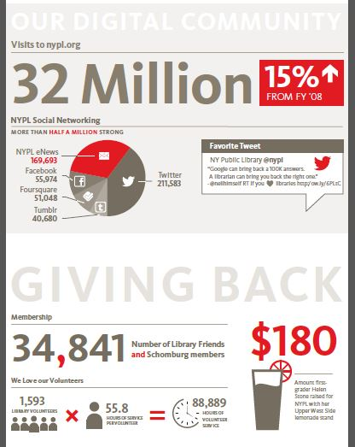

Slide 20
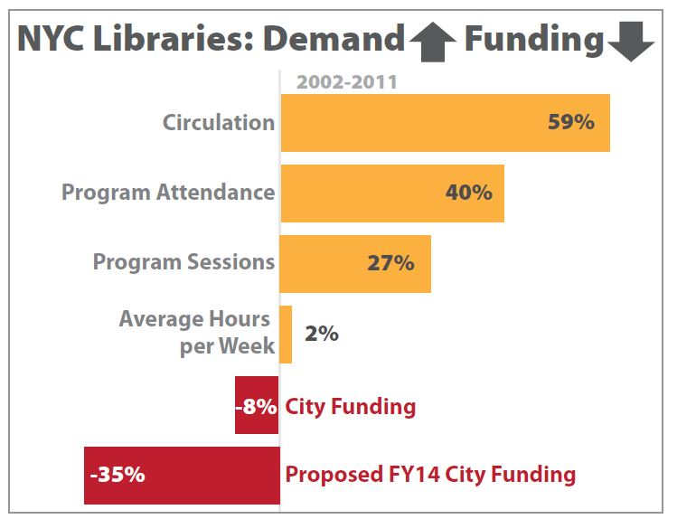
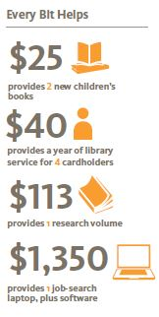
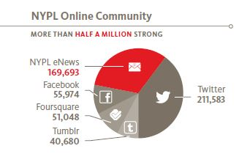

Slide 21
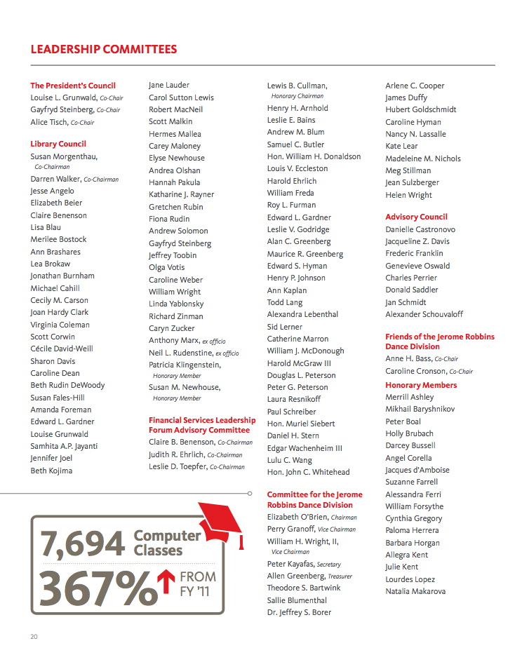

Slide 22
Steps for Success
Begin with numbers
Understand your goals and audience
Establish your approach
Design, refine, repurpose
Share
Notes:
Cohesive story
Breaking down step by step

Slide 23
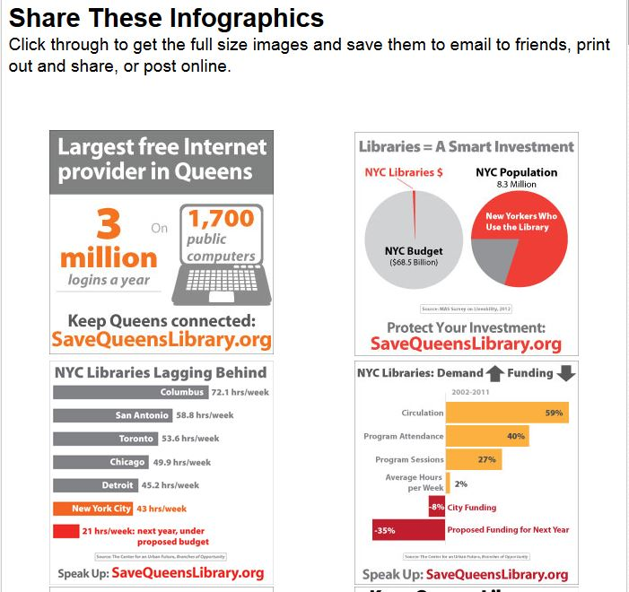

Slide 24
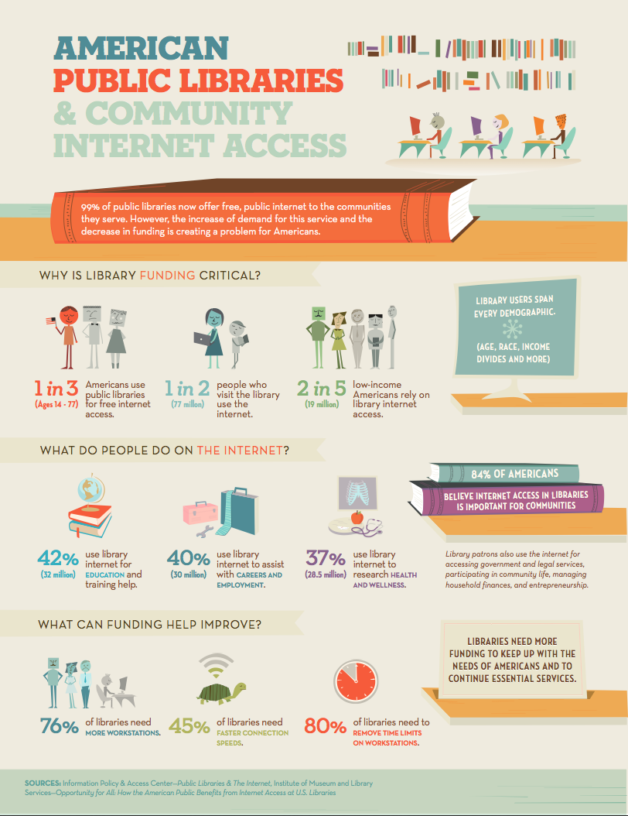

Slide 25
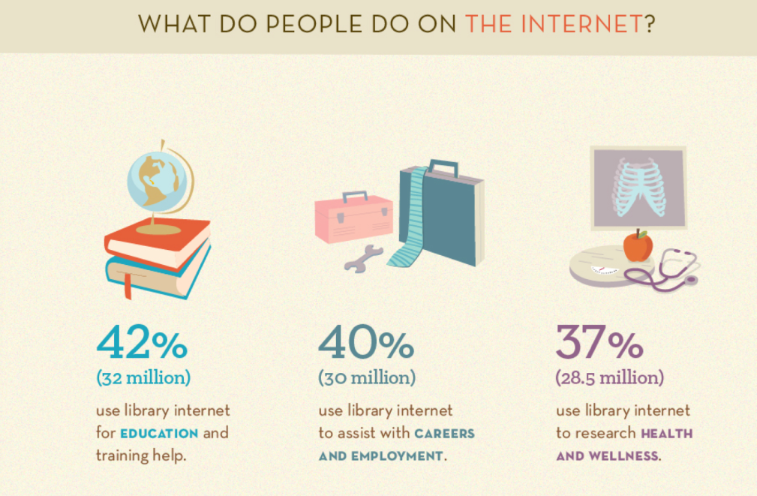
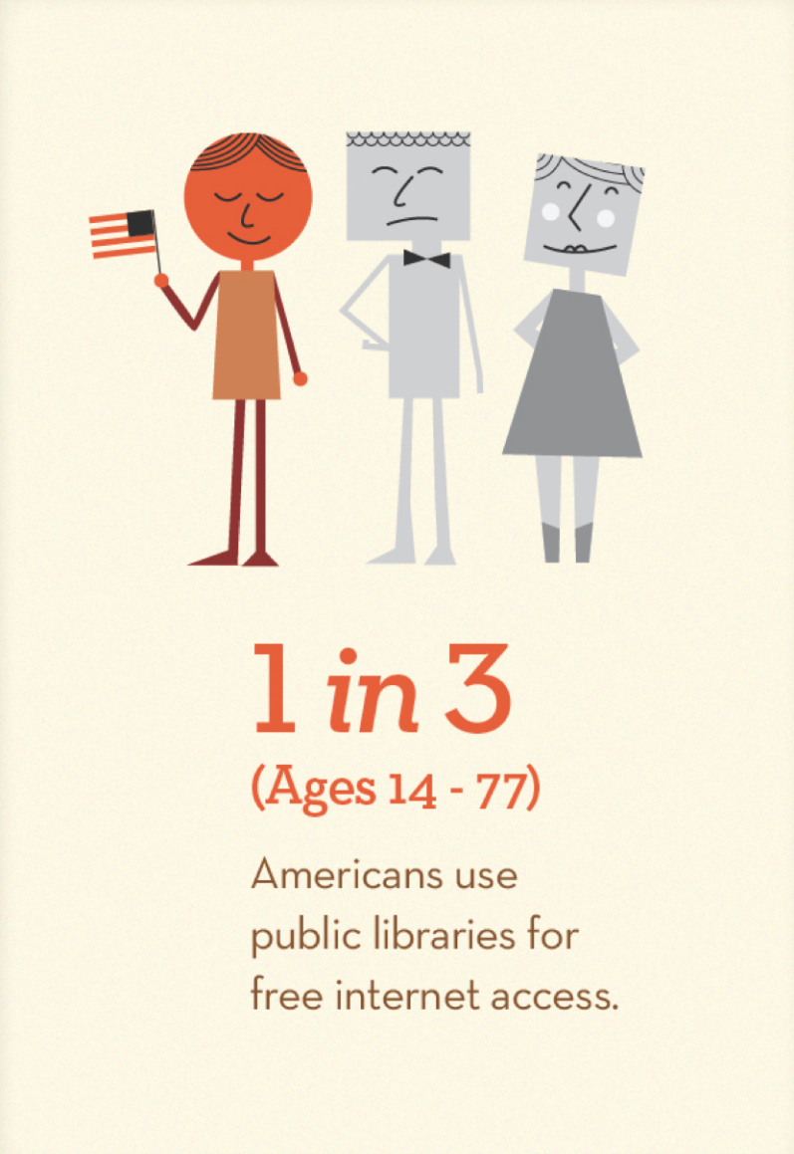
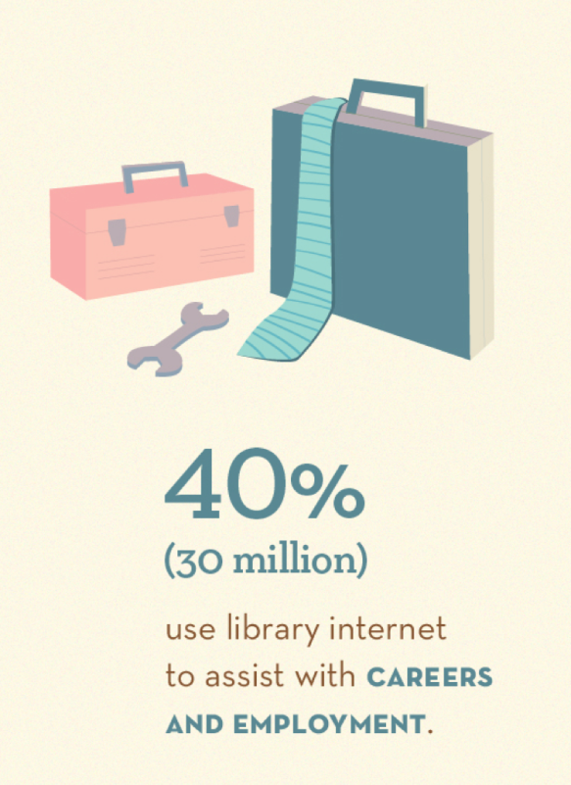

Slide 26
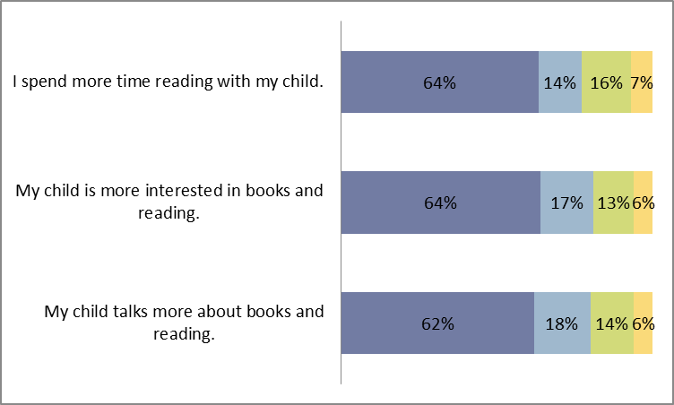
One Book 4 Colorado

Slide 27
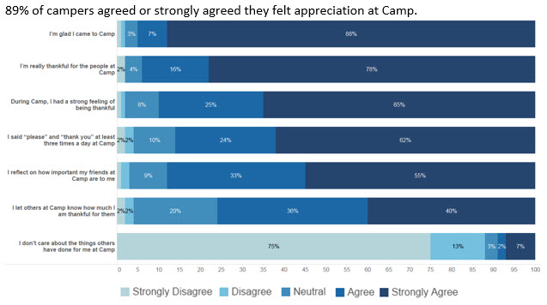
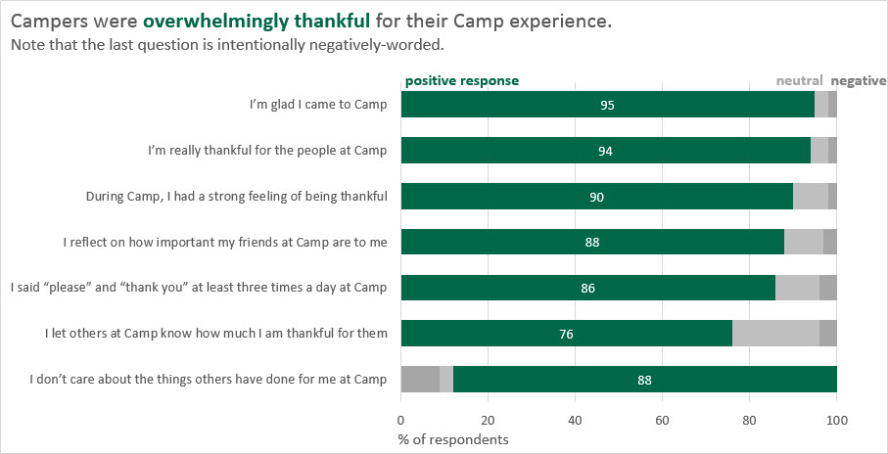
One Book 4 Colorado
http://stephanieevergreen.com/ aggregated-stacked-bars/

Slide 28
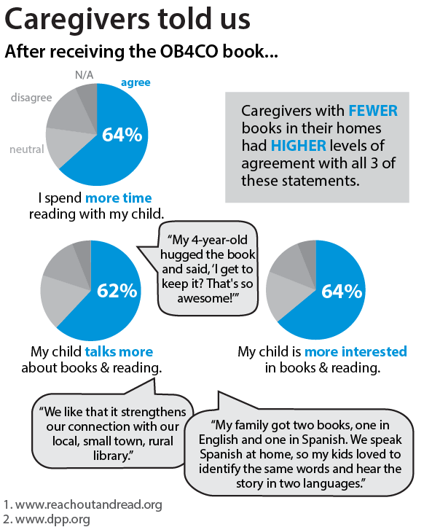
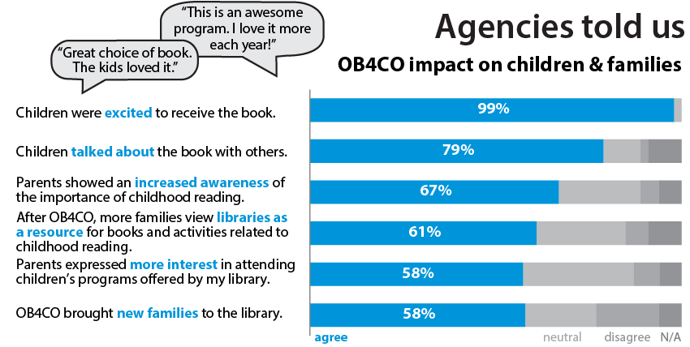
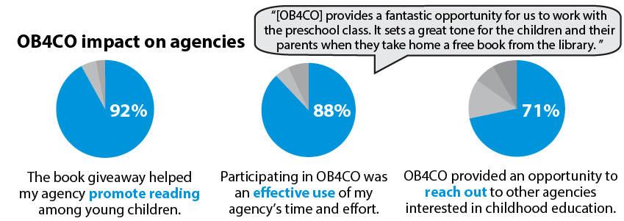
One Book 4 Colorado

Slide 29
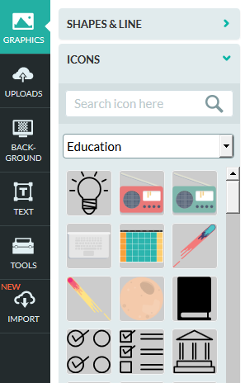
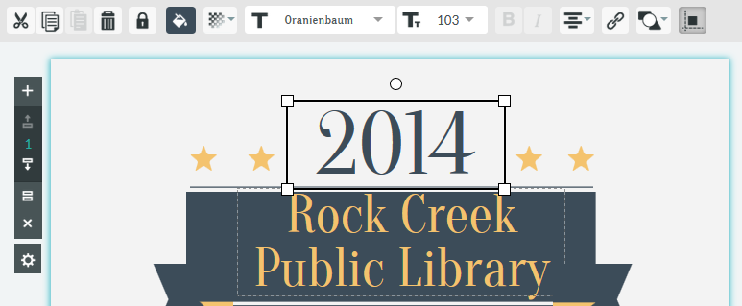
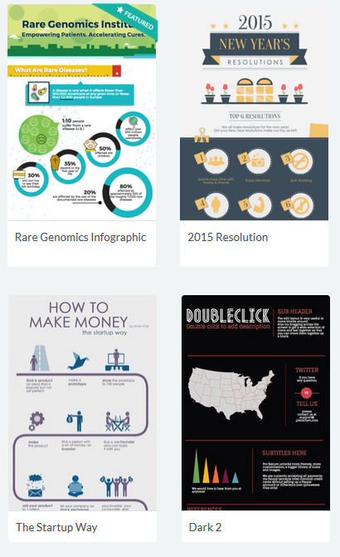
Piktochart
RIPLdataviz / datavizrocks715
Pick template or start from scratch
Edit existing elements or drag and drop new ones
Save, export, and share!
Notes:
Demo:
Drag and drop elements
Templates or create your own
Download as jpg, png, pdf
Publish on web
Created several examples for you to use – log in, create a copy (File < Save As), tweak with your own stats

Slide 30
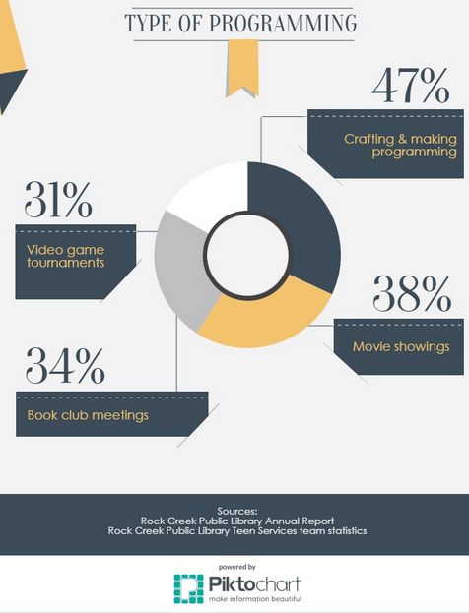
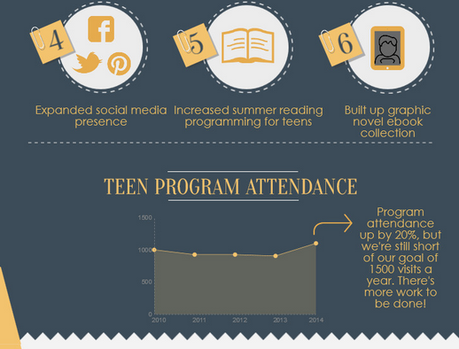
Piktochart

Slide 31
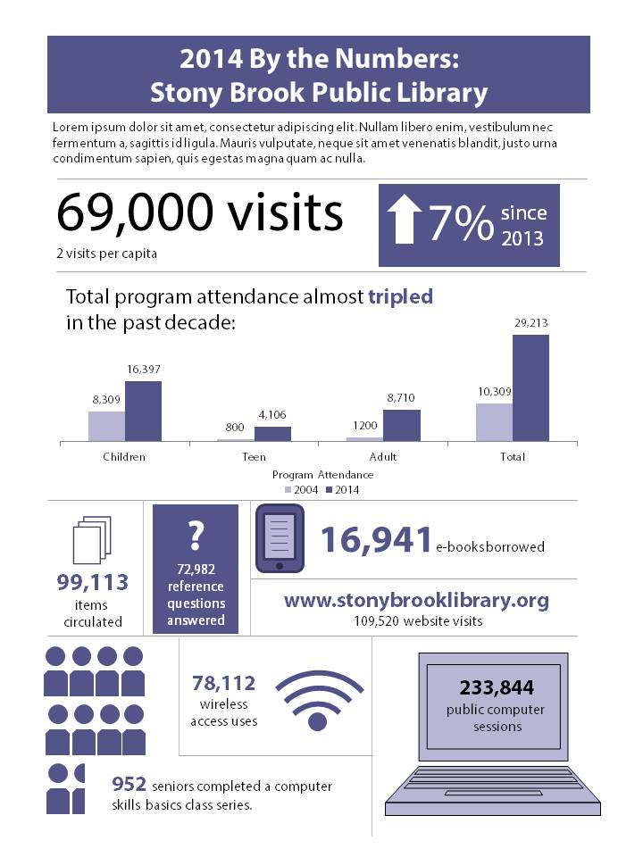
PowerPoint

Slide 32
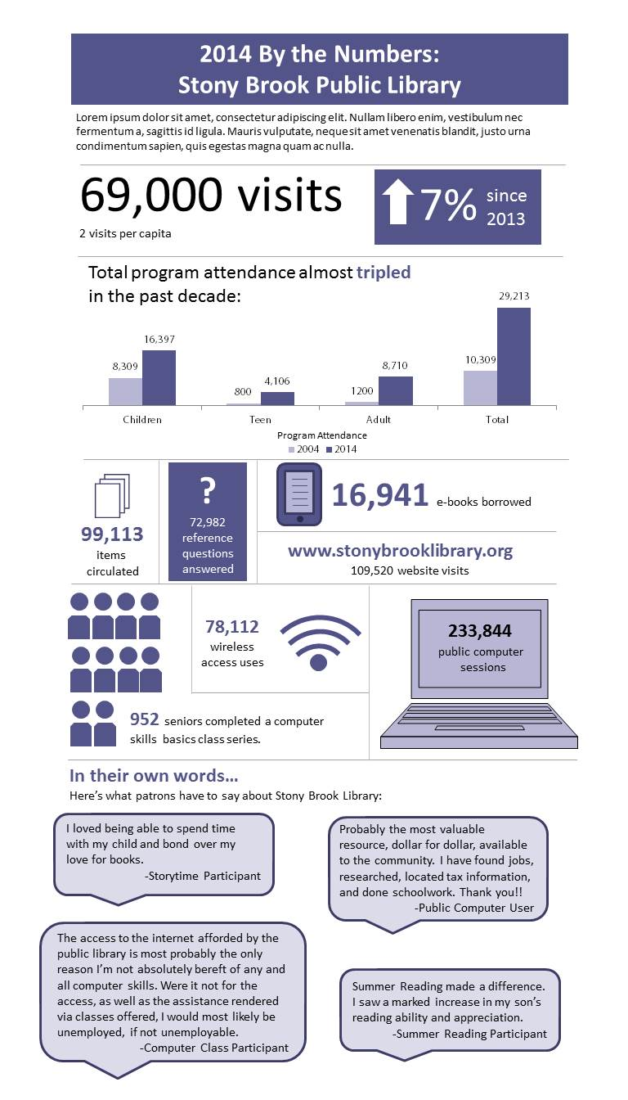

Slide 33
Scenario
You are trying to tell the story of the 21st century library to your community, who believes that libraries are book warehouses.
Using your case study’s Impact Survey results, select several data points to tell this story
Determine a strategy for visually representing the data points

Slide 34
Where we were
Notes:
- technology classes at our flagship location
- anecdotal evidence that people were coming from all over
- wanted to be able to prove that we should be providing these classes elsewhere

Slide 35
One simple question
Notes:
- technology classes at our flagship location
- anecdotal evidence that people were coming from all over
- started asking for zip codes

Slide 36
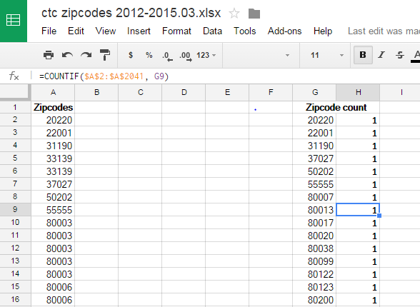
Notes:
Export zipcode data from surveymonkey
Remove duplicates
Excel -> Data -> Data tools -> Remove Duplicates
Google -> Unique (A:A) function
Use excel or Google Docs to do a quick count (function shown)
Sort, determine ranges

Slide 37
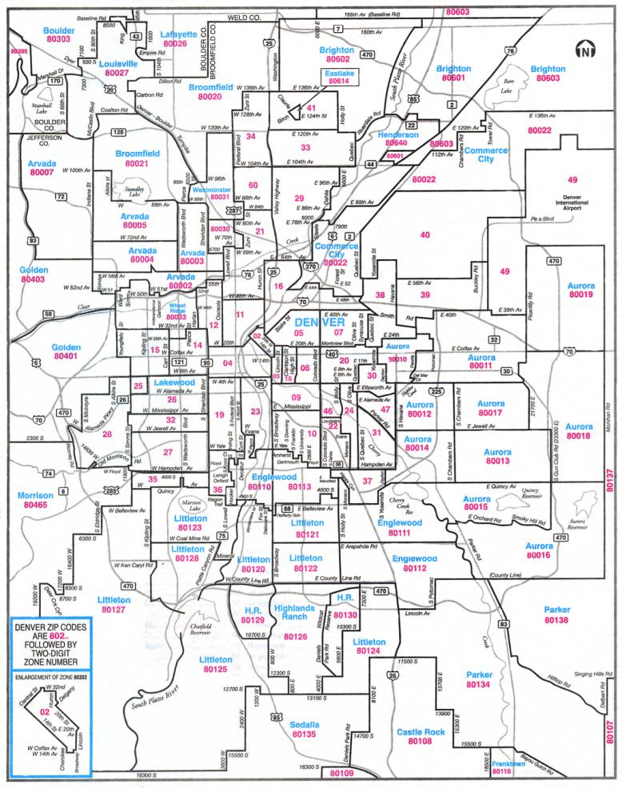
Notes:
This was a google search away - "Denver Zip Code Map"
Use whatever program you want – Photoshop, Gimp, Paint and start coloring

Slide 38
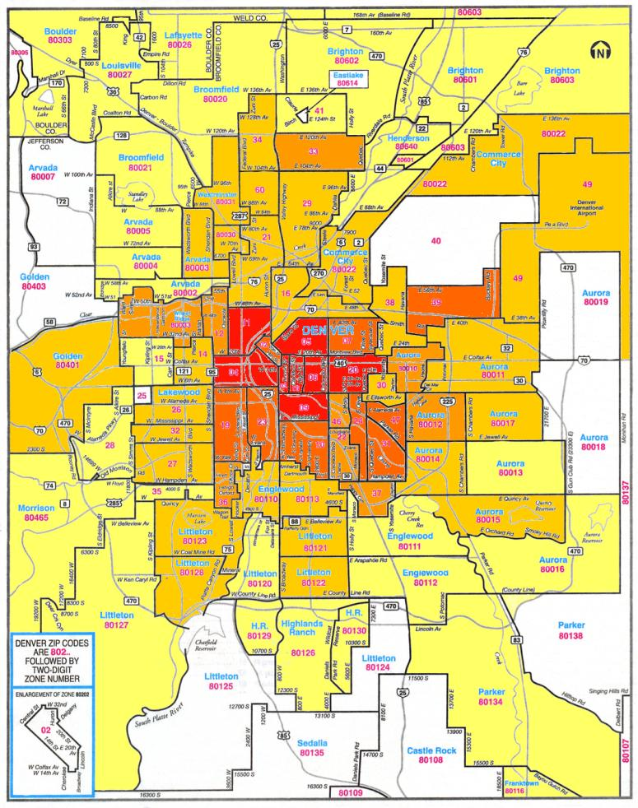
Notes:
Final result
Have used internally to push for more classes at some locations, and determine locations
Have used externally to talk about

Slide 39
Thank You!

