Slide 1
Public Library Annual Report 2023
Charissa Brammer
Dana Petersen
Library Research Service

Slide 2
Why is the Public Library Annual Report Important?
Fulfills statutory requirements in Library Law for reporting
Gives important information to library leadership and your communities
Colorado Public Library Standards support
Adds to Public Library Data
Library Search and Compare (IMLS)
Colorado Library data (since 1997!)
PLA Benchmark
Research across disciplines
IMLS Research Brief: Access to Public Library Services and Materials During the First Nine Months of the COVID-19 Pandemic
The Returns to Public Library Investment (2023) Gilpin, et al.
Households’ Demand for Public Libraries (2020) Gilpin & Bekkerman
Mapping the Impact of Public Library Programming on Youth in the Mountain West (2022) Mitchell, B.
Public Libraries and Walkable Neighborhoods (2019) Lenstra & Carlos

Slide 3
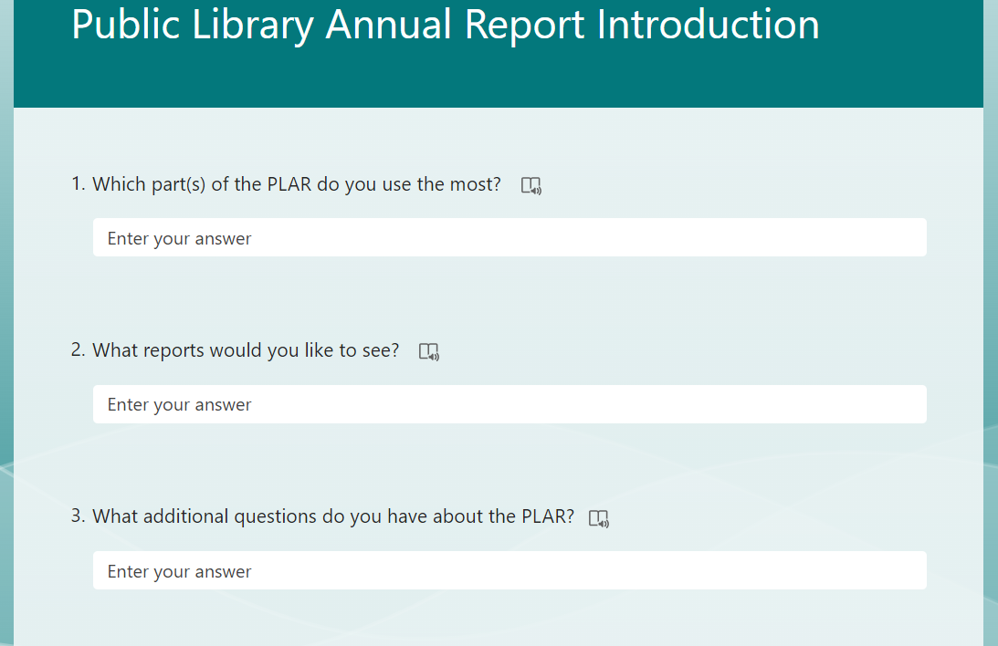
Public Library Annual Report Introduction
https://forms.microsoft.com/r/pL2nubEam3?origin=lprLink

Slide 4
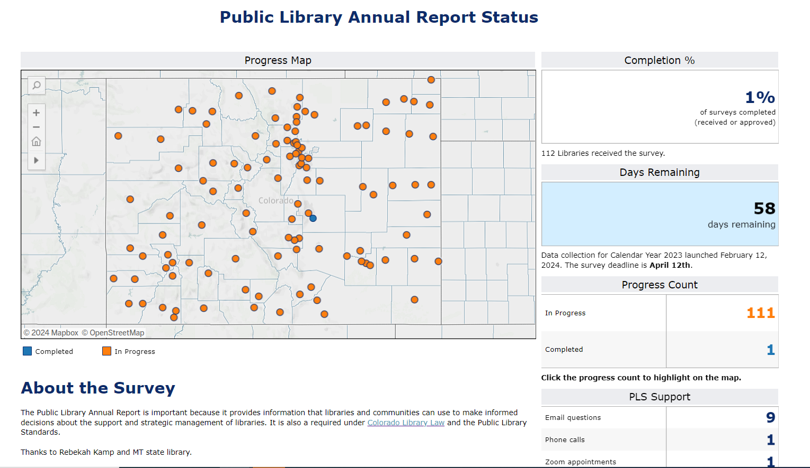
New Status Dashboard
https://public.tableau.com/app/profile/dana.petersen/viz/PLARCompletionStatus/Progress

Slide 5
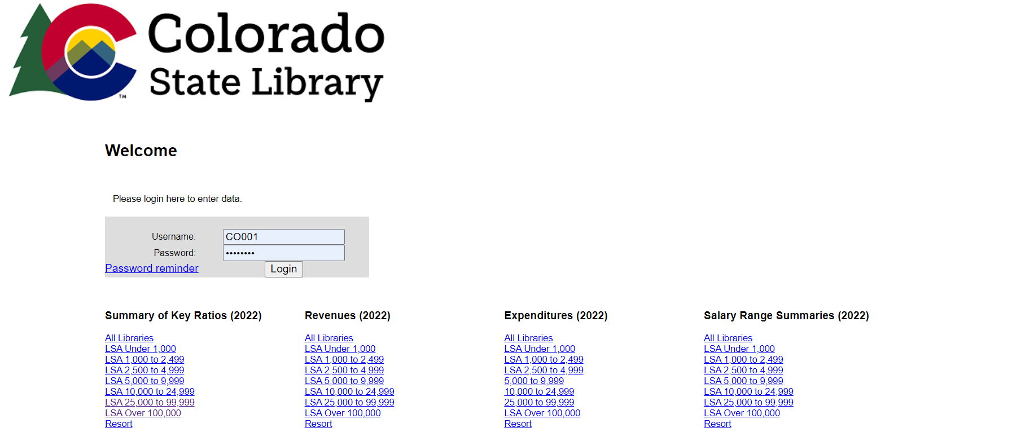
Login Screen
https://colorado.countingopinions.com/
Username and password are in the welcome email from COLORADO@countingopinions.com
Notes:
Contact me if you didn’t receive the welcome email with your login information.
This page also has some links to 2022 canned reports, which we will update for 2023 once we have the information in the system.

Slide 6
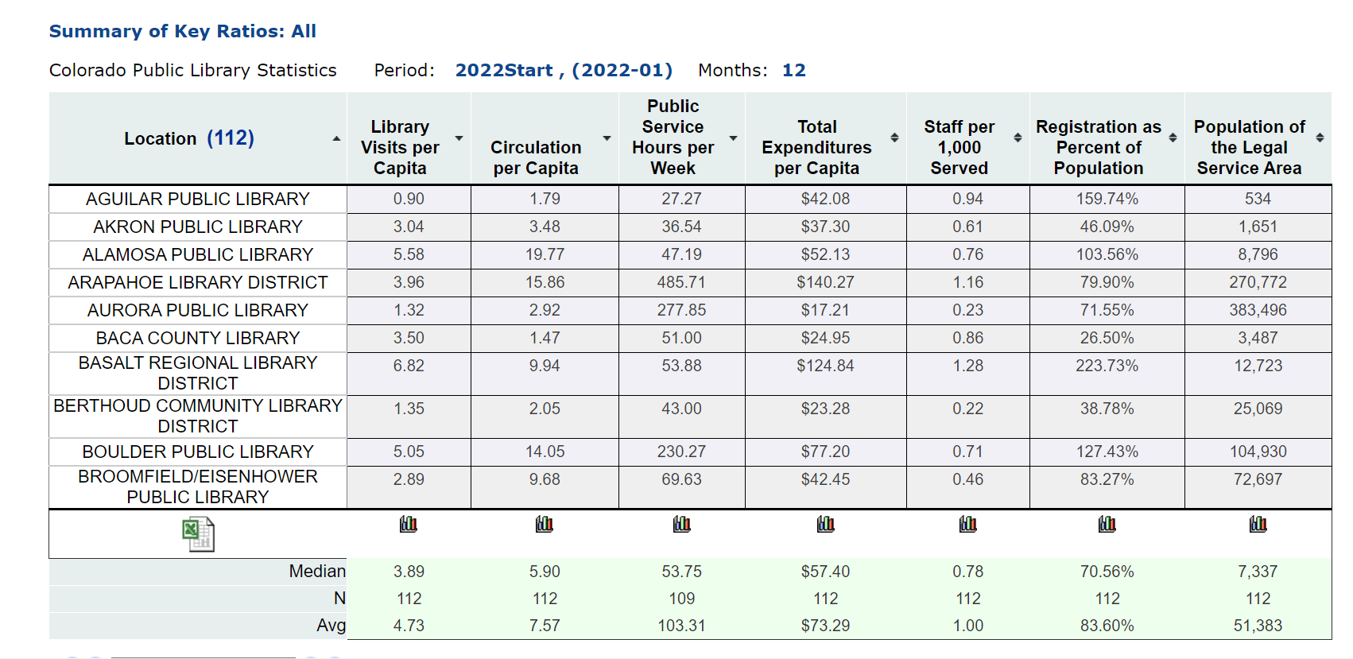
Reports
Notes:
Contact me if you didn’t receive the welcome email with your login information.
This page also has some links to 2022 canned reports, which we will update for 2023 once we have the information in the system.

Slide 7
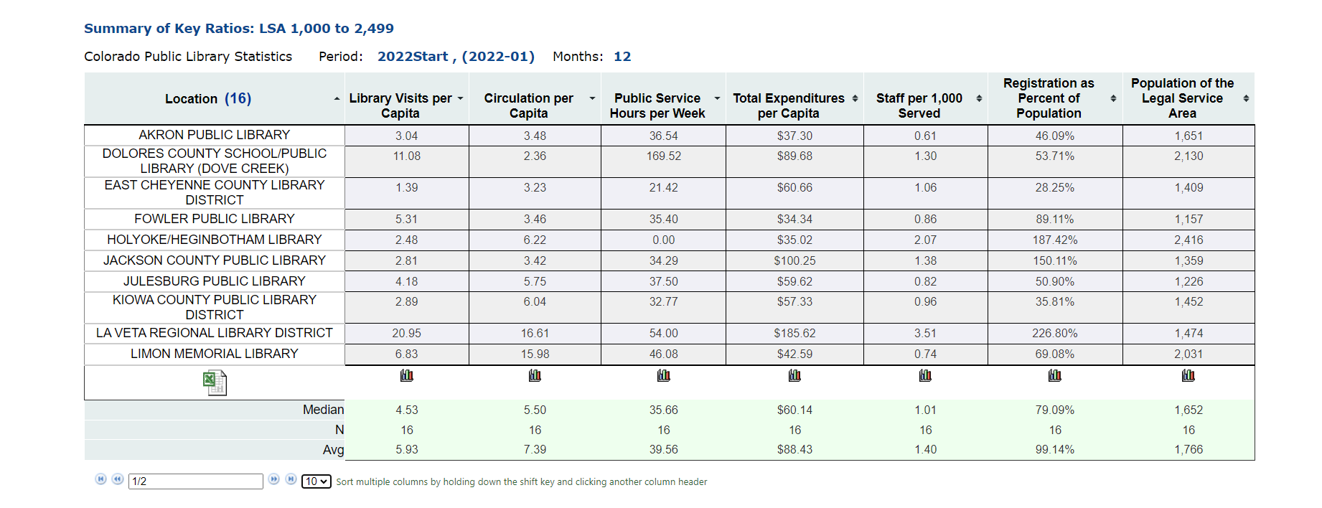
Reports
Notes:
Contact me if you didn’t receive the welcome email with your login information.
This page also has some links to 2022 canned reports, which we will update for 2023 once we have the information in the system.

Slide 8
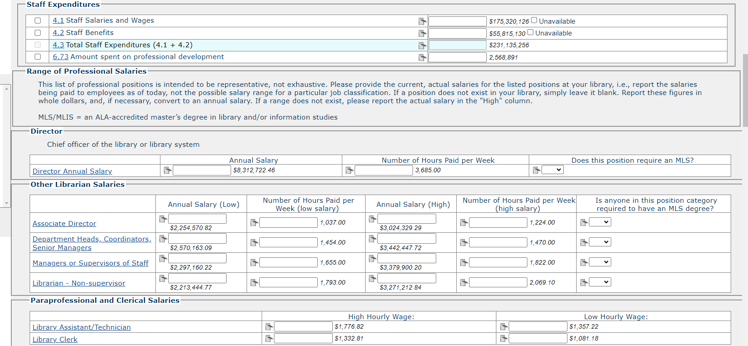
Data Entry
If you do not have a value, please leave blank instead of entering a 0

Slide 9
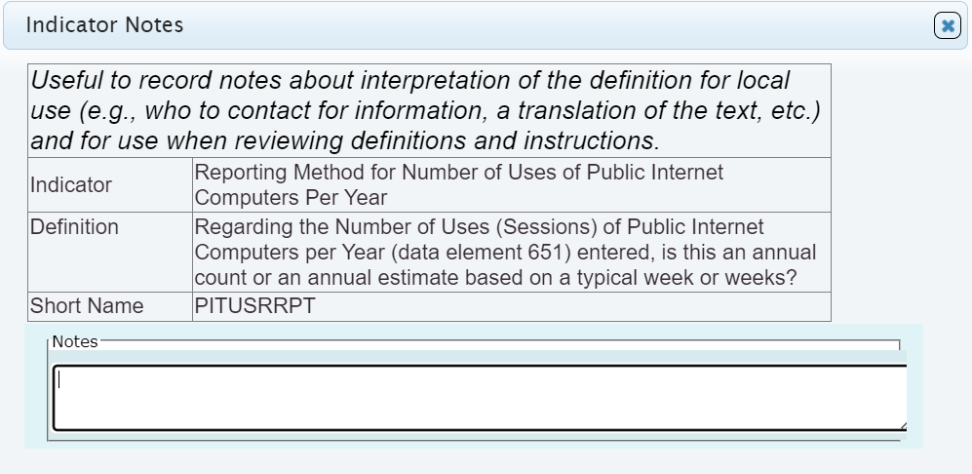
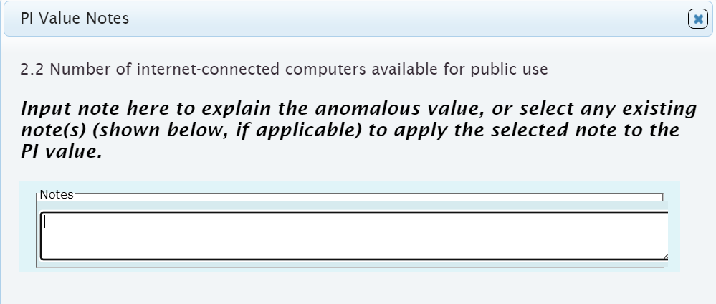
Data Entry
“notes to future self”
“notes to Charissa”

Slide 10
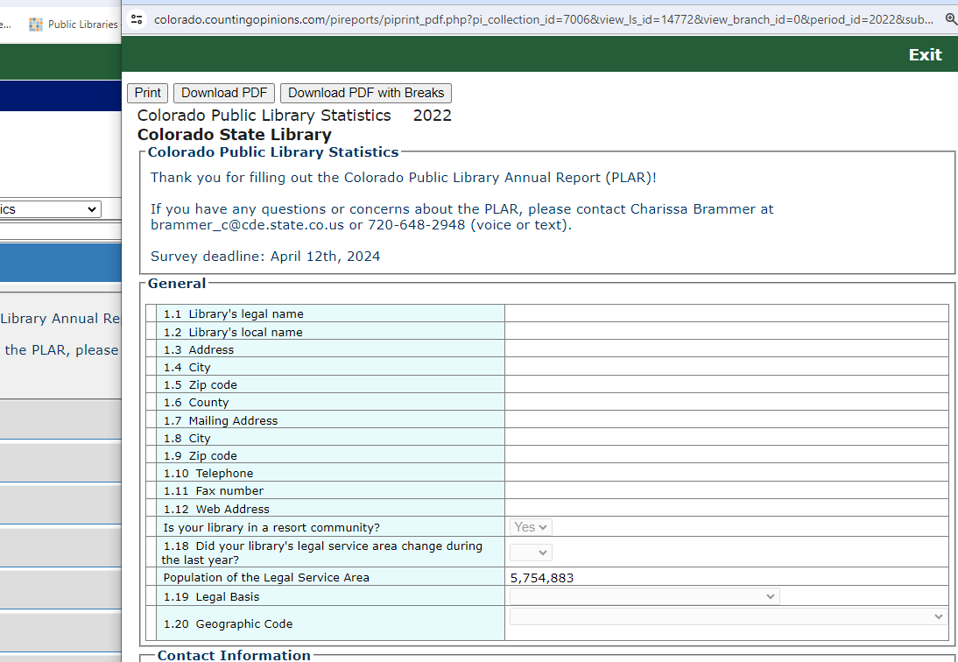
Printing

Slide 11
Data Entry
1.24 Yes = 1 added to total
If a library has 27 branches and one central library, enter
1.24 Yes
1.25 26
If a library has two co-equal branches (none of them are central libraries)
1.24 No
1.25 2
If a library has one location
1.24 Yes
1.25 0

Slide 12
Programming
Live/Synchronous
Programming in the library (onsite)
Programming outside the library (offsite)
Live virtual programming
Asynchronous
Recorded virtual programming
Outreach
This is for events that introduce people to the library but aren’t programs, like tabling at a basketball game or participating in a farmer’s market.

Slide 13
What’s new in 2023 collection
Removed Questions
CV 1-11 COVID-19 questions
2.10 Number of AWE early literacy stations
2.9 Number of public computers with access to commercial databases
2.3 Number of weeks that no computers were available for public use
2.4 If you library had to limit the number of computers available for public use during part of [year], what was the lowest number of computers available
Changed questions
Updated the way that public service hours are calculated, using the total of hours for Outlets to add up automatically to the Public Service Hours for the system.

Slide 14
What’s new in the 2023 collection
Added
15.21 How many study rooms does this outlet have that are available for public use?
15.21a Study room(s) use
17.1 Do you have positions at your library that require the person in the position to be able to communicate in languages other than English?
If yes, how many?
If yes, which languages?
17.2 Do you have multilingual people on staff using languages other than English to help patrons, but that is not an official part of their job?
If yes, how many?
If yes, which languages?
17.3 Does your library offer programs in a language other than English?
If yes, which languages?

Slide 15
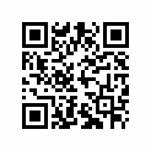
Thank you!
Please take our survey
https://survey.alchemer.com/s3/7416241/brammer-c
This project was made possible in part by the Institute of Museum and Library Services

